Slide 1
Illustrated Transformer https://jalammar.github.io/illustrated-transformer/

Slide 2
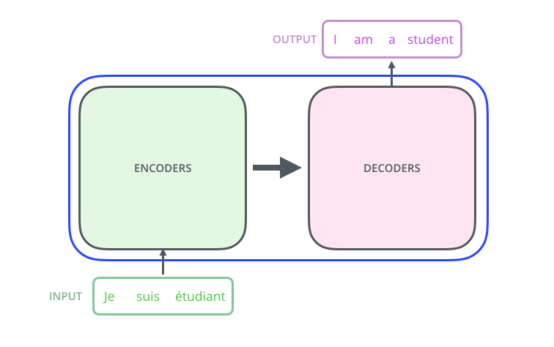
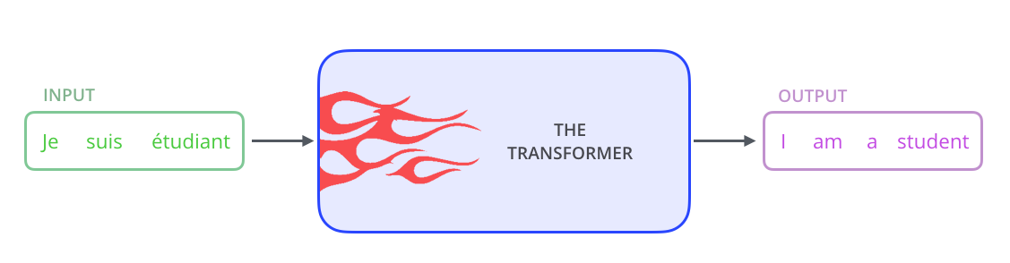
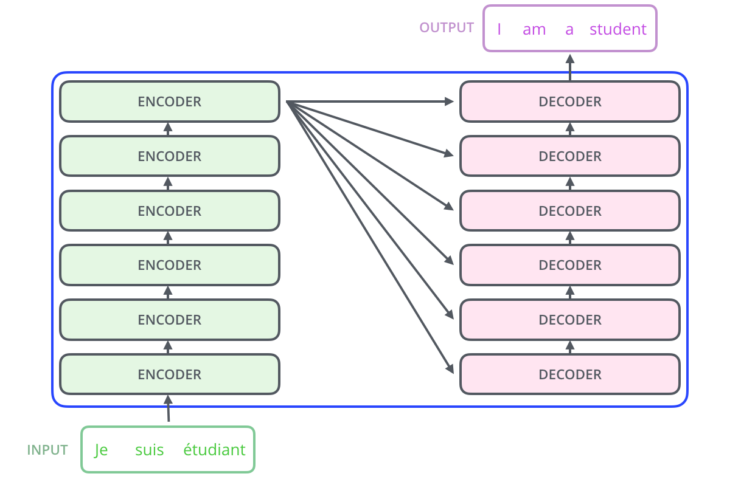
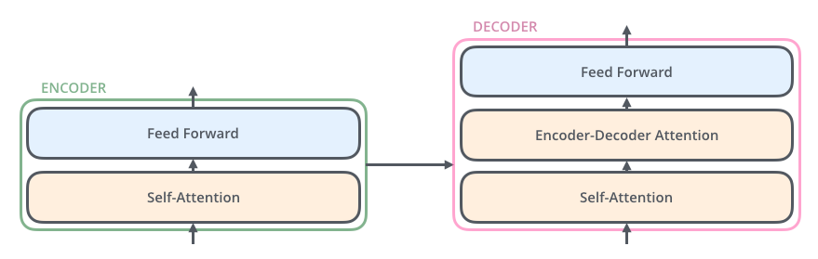
Transformer
Notes:
The encoding component is a stack of encoders (the paper stacks six of them on top of each other – there’s nothing magical about the number six, one can definitely experiment with other arrangements). The decoding component is a stack of decoders of the same number.

Slide 3
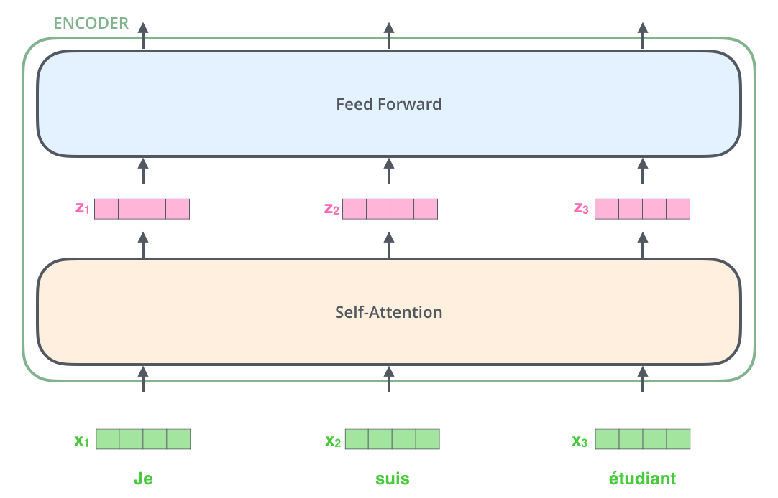
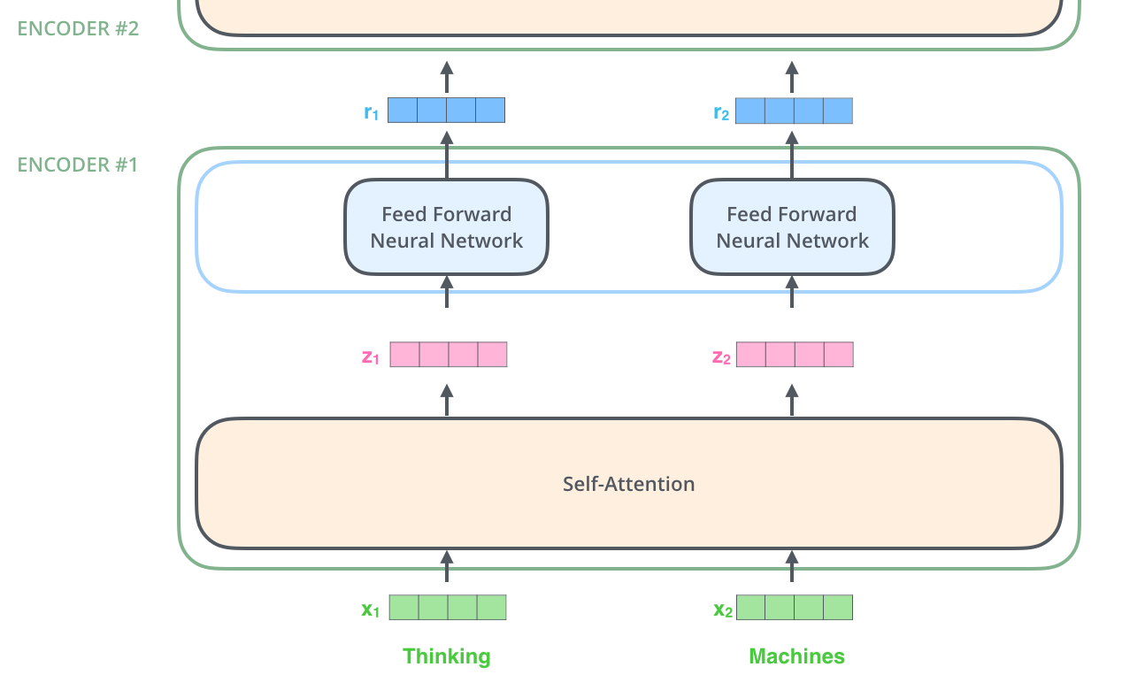
Encoder
Notes:
The embedding only happens in the bottom-most encoder. The abstraction that is common to all the encoders is that they receive a list of vectors each of the size 512 – In the bottom encoder that would be the word embeddings, but in other encoders, it would be the output of the encoder that’s directly below. The size of this list is hyperparameter we can set – basically it would be the length of the longest sentence in our training dataset.
Here we begin to see one key property of the Transformer, which is that the word in each position flows through its own path in the encoder. There are dependencies between these paths in the self-attention layer. The feed-forward layer does not have those dependencies, however, and thus the various paths can be executed in parallel while flowing through the feed-forward layer.

Slide 4
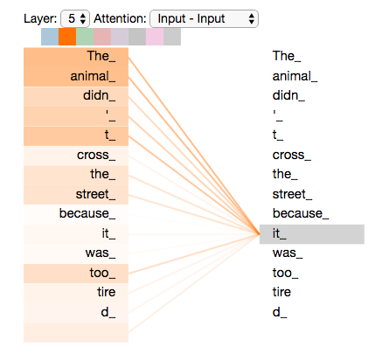
Attention
sentence we want to translate:
”The animal didn't cross the
street because it was too tired”
What does “it” in this sentence refer to?
Notes:
What does “it” in this sentence refer to? Is it referring to the street or to the animal? It’s a simple question to a human, but not as simple to an algorithm.
When the model is processing the word “it”, self-attention allows it to associate “it” with “animal”.
As the model processes each word (each position in the input sequence), self attention allows it to look at other positions in the input sequence for clues that can help lead to a better encoding for this word.

Slide 5
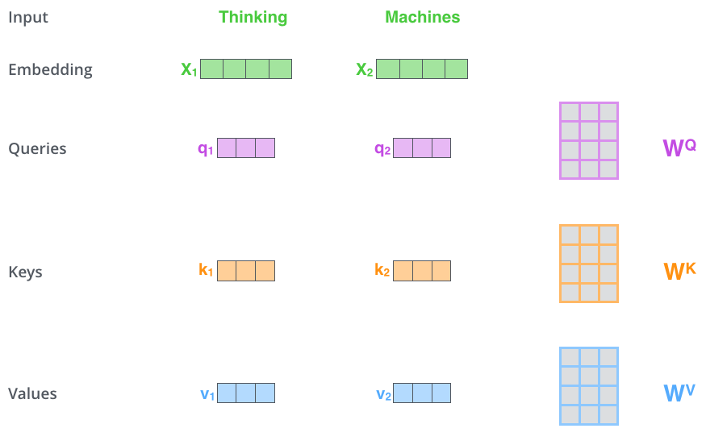
Self Attention
Notes:
Let’s first look at how to calculate self-attention using vectors, then proceed to look at how it’s actually implemented – using matrices.
The first step in calculating self-attention is to create three vectors from each of the encoder’s input vectors (in this case, the embedding of each word). So for each word, we create a Query vector, a Key vector, and a Value vector. These vectors are created by multiplying the embedding by three matrices that we trained during the training process.
Notice that these new vectors are smaller in dimension than the embedding vector. Their dimensionality is 64, while the embedding and encoder input/output vectors have dimensionality of 512. They don’t HAVE to be smaller, this is an architecture choice to make the computation of multiheaded attention (mostly) constant.

Slide 6
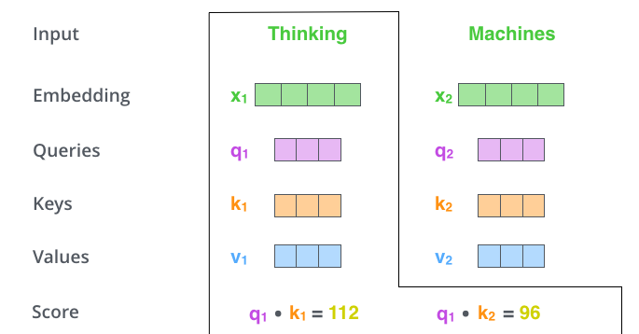
Self-Attention
Notes:
The second step in calculating self-attention is to calculate a score. Say we’re calculating the self-attention for the first word in this example, “Thinking”. We need to score each word of the input sentence against this word. The score determines how much focus to place on other parts of the input sentence as we encode a word at a certain position.
The score is calculated by taking the dot product of the query vector with the key vector of the respective word we’re scoring. So if we’re processing the self-attention for the word in position #1, the first score would be the dot product of q1 and k1. The second score would be the dot product of q1 and k2.

Slide 7
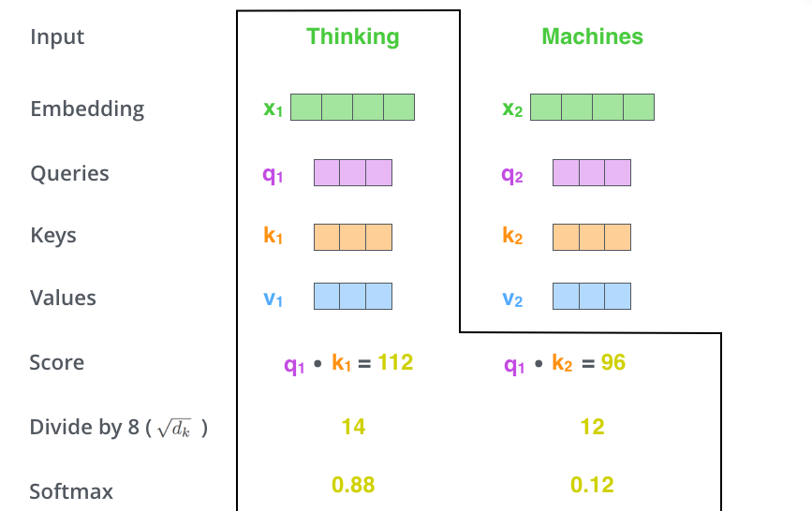
Self Attention
Notes:
This softmax score determines how much each word will be expressed at this position. Clearly the word at this position will have the highest softmax score, but sometimes it’s useful to attend to another word that is relevant to the current word.

Slide 8
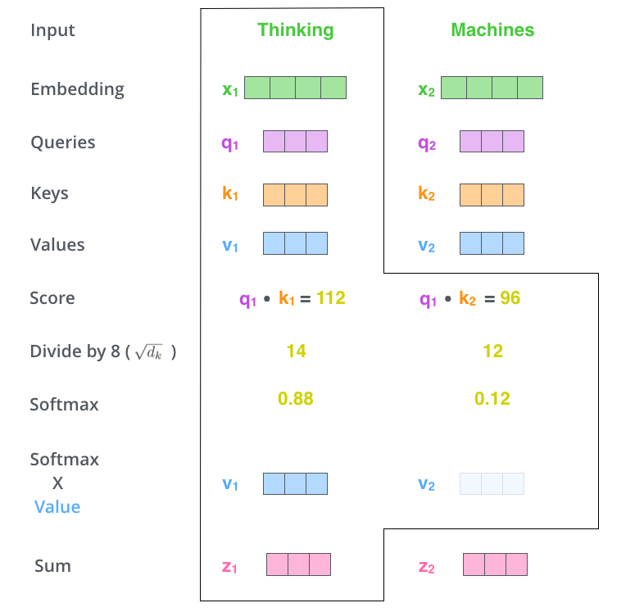
Self_Attention
Notes:
The fifth step is to multiply each value vector by the softmax score (in preparation to sum them up). The intuition here is to keep intact the values of the word(s) we want to focus on, and drown-out irrelevant words (by multiplying them by tiny numbers like 0.001, for example).
The sixth step is to sum up the weighted value vectors. This produces the output of the self-attention layer at this position (for the first word).
That concludes the self-attention calculation. The resulting vector is one we can send along to the feed-forward neural network. In the actual implementation, however, this calculation is done in matrix form for faster processing. So let’s look at that now that we’ve seen the intuition of the calculation on the word level.

Slide 9
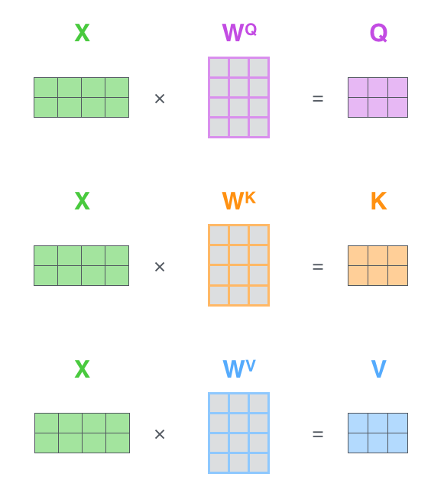
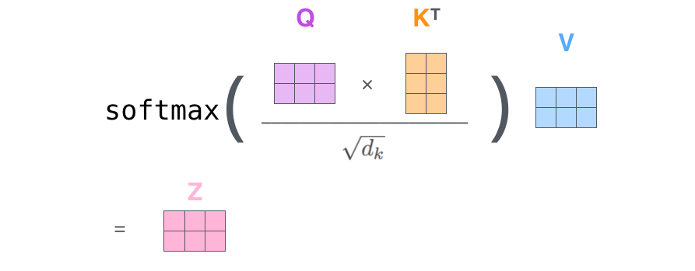
Matrix Calculation for Self Attention
Notes:
The first step is to calculate the Query, Key, and Value matrices. We do that by packing our embeddings into a matrix X, and multiplying it by the weight matrices we’ve trained (WQ, WK, WV).
Finally, since we’re dealing with matrices, we can condense steps two through six in one formula to calculate the outputs of the self-attention layer.

Slide 10
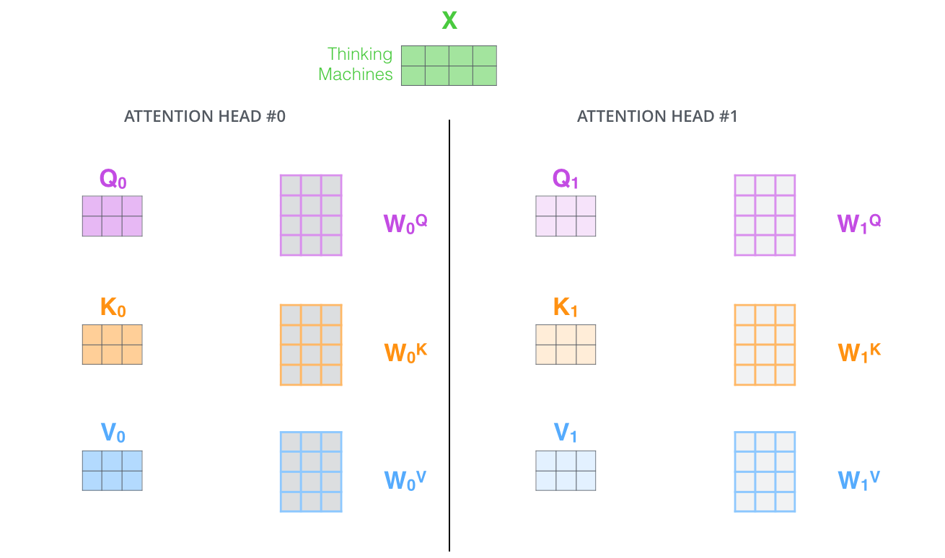
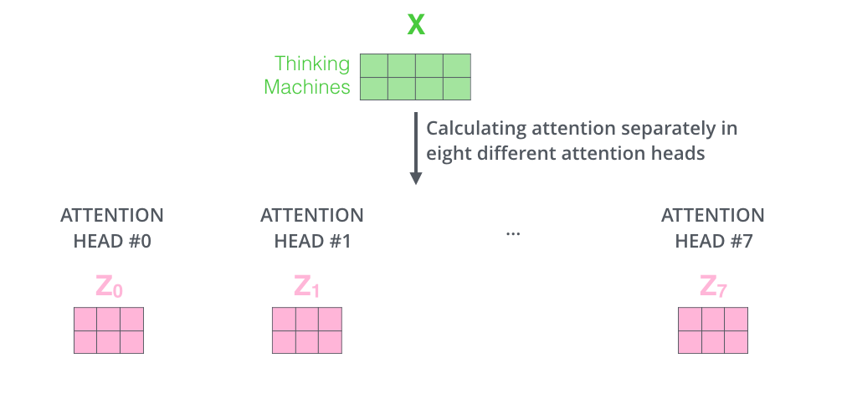
Multi-Headed Attention
Notes:
The paper further refined the self-attention layer by adding a mechanism called “multi-headed” attention. This improves the performance of the attention layer in two ways:
It expands the model’s ability to focus on different positions. Yes, in the example above, z1 contains a little bit of every other encoding, but it could be dominated by the actual word itself. If we’re translating a sentence like “The animal didn’t cross the street because it was too tired”, it would be useful to know which word “it” refers to.
It gives the attention layer multiple “representation subspaces”. As we’ll see next, with multi-headed attention we have not only one, but multiple sets of Query/Key/Value weight matrices (the Transformer uses eight attention heads, so we end up with eight sets for each encoder/decoder). Each of these sets is randomly initialized. Then, after training, each set is used to project the input embeddings (or vectors from lower encoders/decoders) into a different representation subspace.

Slide 11
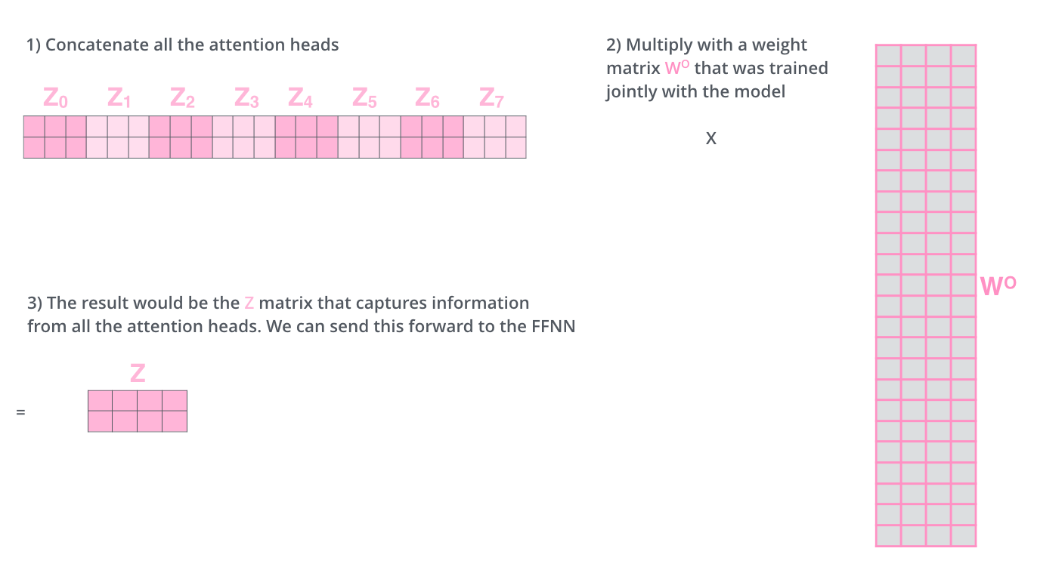
Multi-Headed Attention

Slide 12
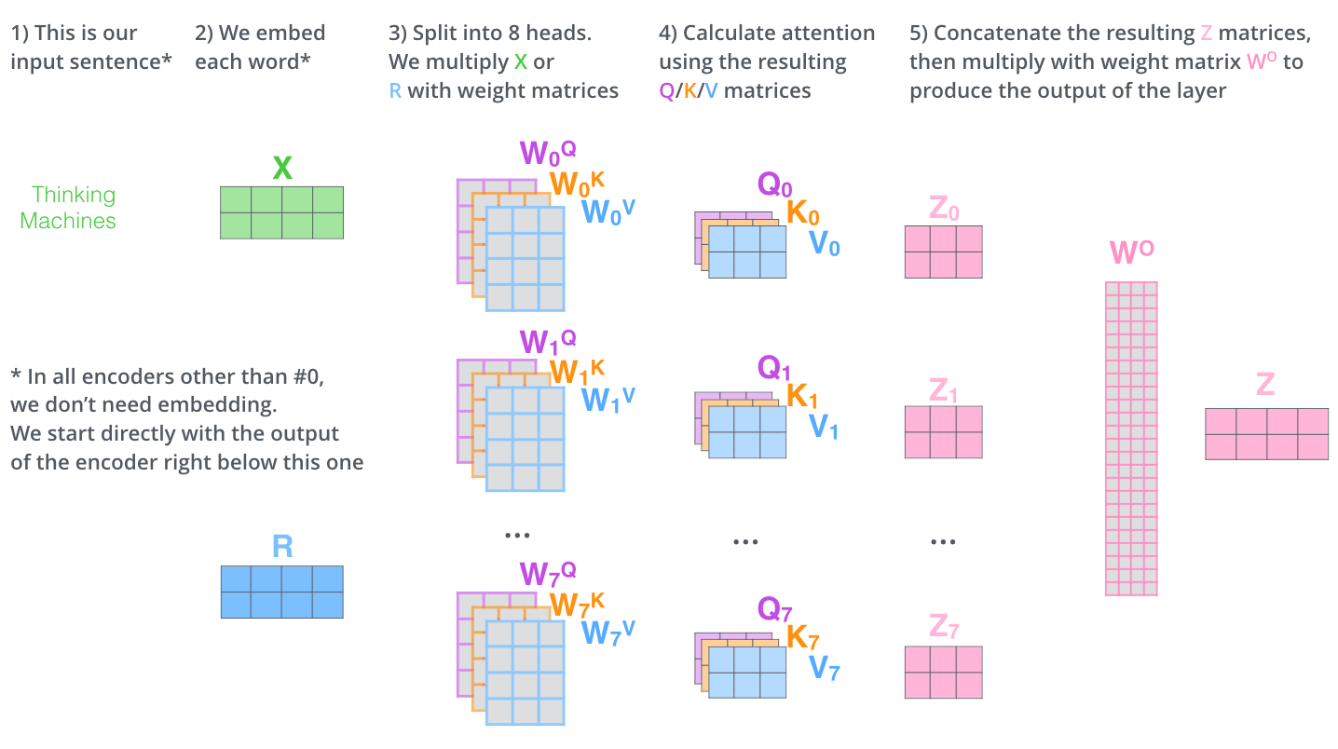

Slide 13
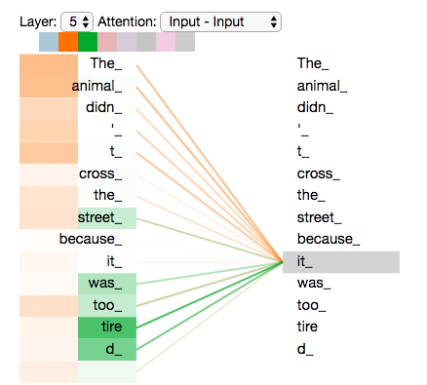
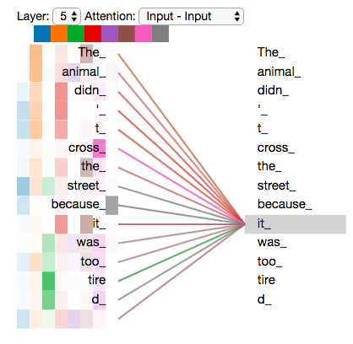
What Multi-heads doing
Notes:
Now that we have touched upon attention heads, let’s revisit our example from before to see where the different attention heads are focusing as we encode the word “it” in our example sentence:
If we add all the attention heads to the picture, however, things can be harder to interpret:

Slide 14
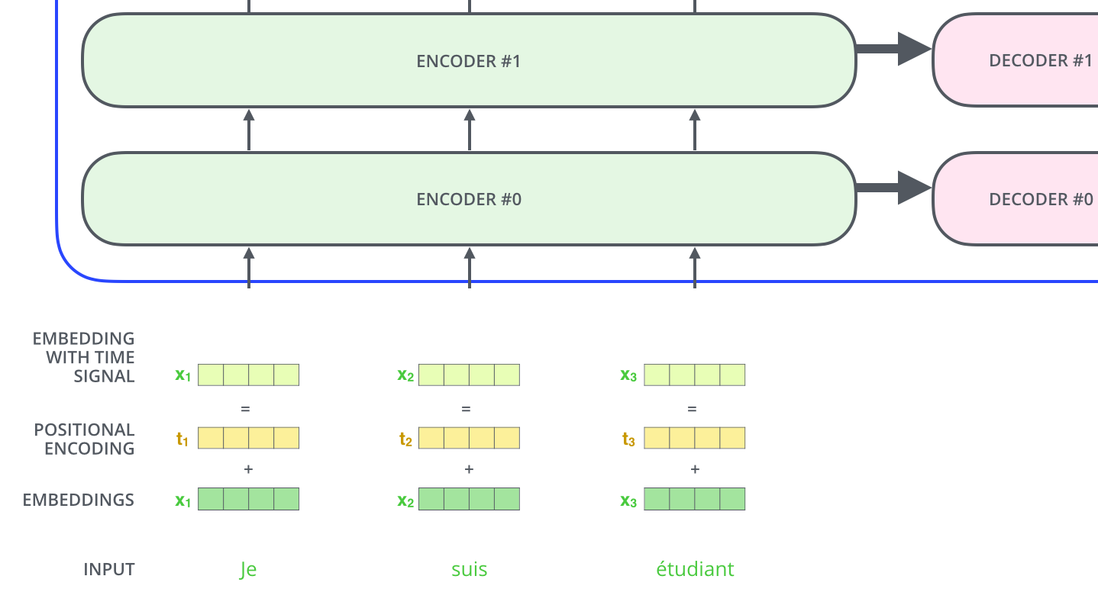
Order of The Sequence -Positional Encoding
Notes:
To address this, the transformer adds a vector to each input embedding. These vectors follow a specific pattern that the model learns, which helps it determine the position of each word, or the distance between different words in the sequence. The intuition here is that adding these values to the embeddings provides meaningful distances between the embedding vectors once they’re projected into Q/K/V vectors and during dot-product attention.

Slide 15
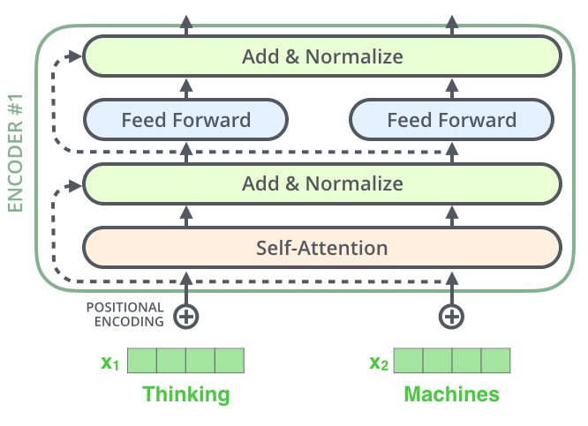
Residuals
Notes:
One detail in the architecture of the encoder that we need to mention before moving on, is that each sub-layer (self-attention, ffnn) in each encoder has a residual connection around it, and is followed by a layer-normalization step.

Slide 16
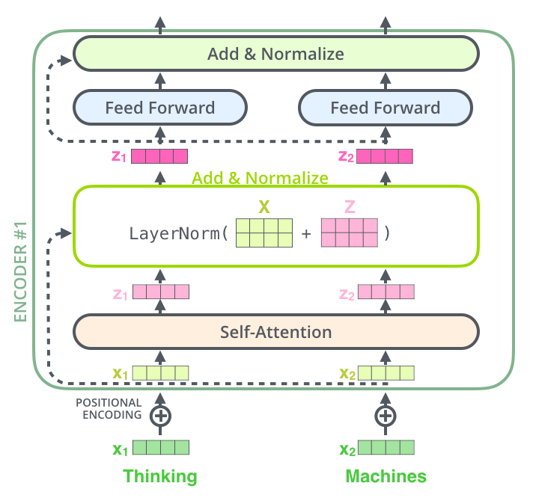
Notes:
If we’re to visualize the vectors and the layer-norm operation associated with self attention, it would look like this:

Slide 17
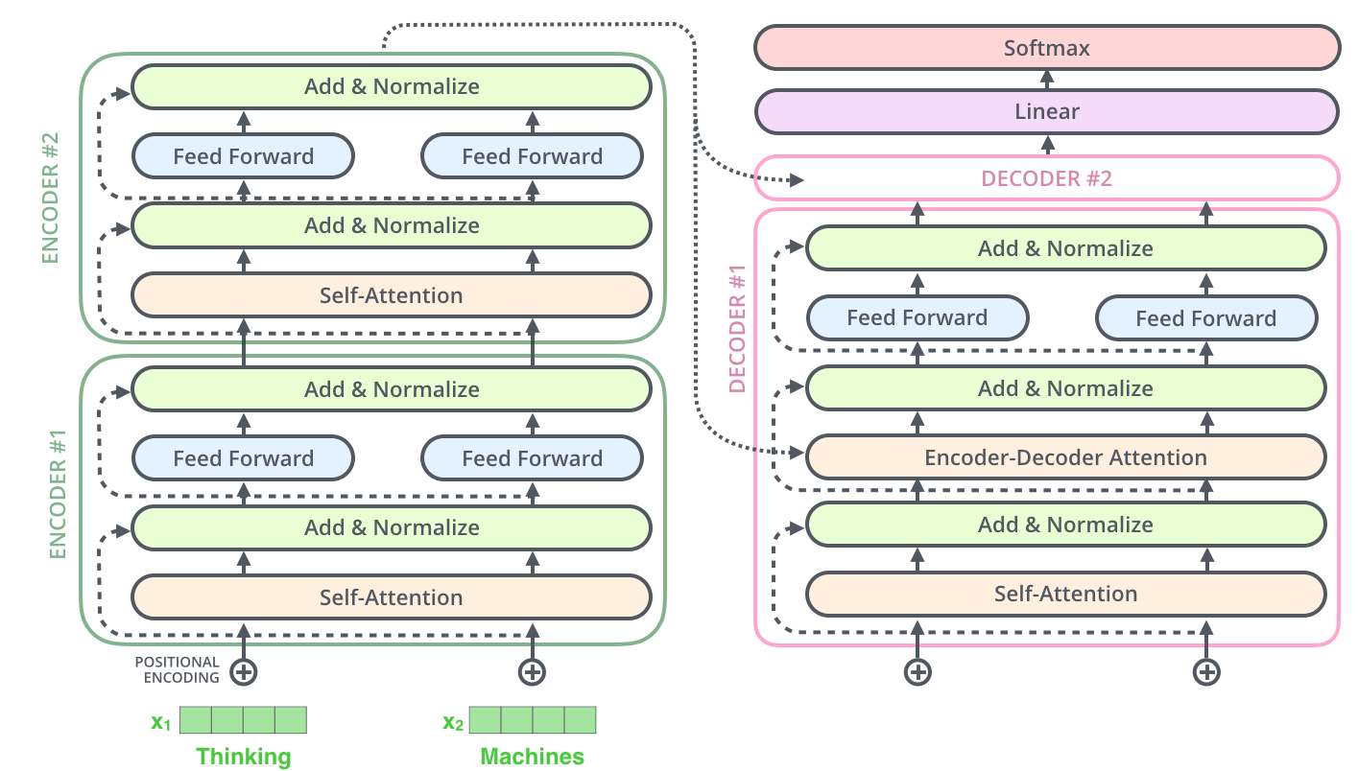
Encoder-Decoder
Notes:
This goes for the sub-layers of the decoder as well. If we’re to think of a Transformer of 2 stacked encoders and decoders, it would look something like this:

Slide 18
Decoder
Notes:
The encoder start by processing the input sequence. The output of the top encoder is then transformed into a set of attention vectors K and V. These are to be used by each decoder in its “encoder-decoder attention” layer which helps the decoder focus on appropriate places in the input sequence:

Slide 19
Decoder
Notes:
The following steps repeat the process until a special symbol is reached indicating the transformer decoder has completed its output. The output of each step is fed to the bottom decoder in the next time step, and the decoders bubble up their decoding results just like the encoders did. And just like we did with the encoder inputs, we embed and add positional encoding to those decoder inputs to indicate the position of each word.
The self attention layers in the decoder operate in a slightly different way than the one in the encoder:
In the decoder, the self-attention layer is only allowed to attend to earlier positions in the output sequence. This is done by masking future positions (setting them to -inf) before the softmax step in the self-attention calculation.
The “Encoder-Decoder Attention” layer works just like multiheaded self-attention, except it creates its Queries matrix from the layer below it, and takes the Keys and Values matrix from the output of the encoder stack.

Slide 20
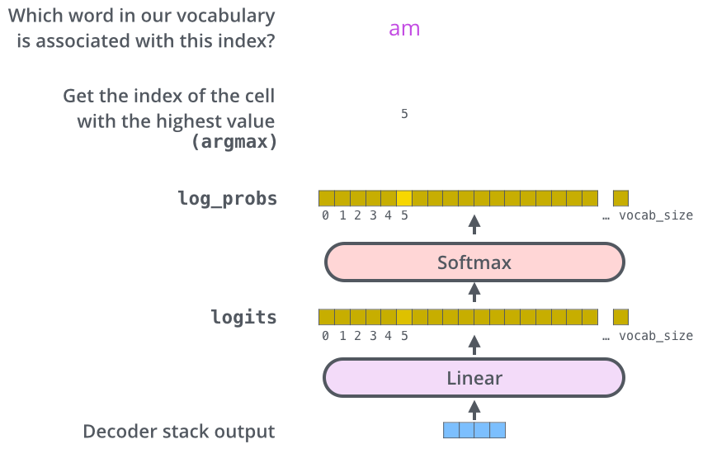
Final Layer
Notes:
The decoder stack outputs a vector of floats. How do we turn that into a word? That’s the job of the final Linear layer which is followed by a Softmax Layer.
The Linear layer is a simple fully connected neural network that projects the vector produced by the stack of decoders, into a much, much larger vector called a logits vector.
Let’s assume that our model knows 10,000 unique English words (our model’s “output vocabulary”) that it’s learned from its training dataset. This would make the logits vector 10,000 cells wide – each cell corresponding to the score of a unique word. That is how we interpret the output of the model followed by the Linear layer.
The softmax layer then turns those scores into probabilities (all positive, all add up to 1.0). The cell with the highest probability is chosen, and the word associated with it is produced as the output for this time step.

